Slide 1
Agile Software Development Models

Slide 2
Agile
Agile is mindset rather than a process model.
It is develop to overcome the problems in traditional models.
It focuses on adaption of change and collaboration in teams and individuals.

Slide 3
Agile Manifesto
As industry was finding issues in traditional models, several teams and several leaders were trying different matters like Crystal, XP, Scrum.
And they were getting some success. The fundamental idea behind most of this models was to reduce the learning cycle. How can we learn faster? And to increase the collaboration between the team members.
So as these teams and as these leaders were finding success in their methods, they thought let's get together and find out what is it that we are doing that is making us successful?
And what is it that is common? So these 17 individuals, they came together in February, 2001, in a ski resort and talked about each of their method and said what is working and what is common in all of these methods?
What came out of this meeting was symbolic. The manifesto for agile software development. It consists of four values and 12 principles. As you can see, they didn't define a new model or a process, they defined a mindset, an agile mindset, that help teams build better software.

Slide 4
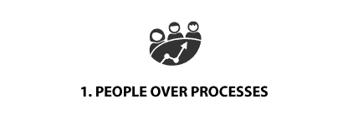
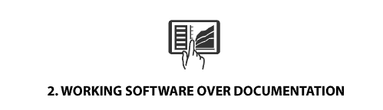
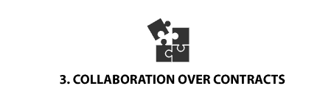
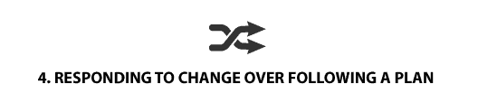
Agile Manifesto (Values)
Individual and Interaction over Processes and tools
Working Software over Comprehensive documentation
Customer Collaboration over Contract Negotiation
Responding to change over Following a plan
Please watch the following video that provides a very high level explanation of Agile Manifesto values
https://www.youtube.com/watch?v=rf8Gi2RLKWQ

Slide 5
Agile Manifesto (Principle)
Provide customer satisfaction through early and continuous software delivery
Accommodate changing requirements throughout the development process
Supply frequent delivery of working software
Collaborate between the business stakeholders and developers throughout the project
Support, trust, and motivate the people involved
Enable face-to-face interactions
Measure progress through working software
Use Agile processes to support a consistent development pace
Enhance agility through attention to technical detail and design
Keep things simple by developing just enough to get the job done for right now
Self-organize teams to encourage great architectures, requirements, and designs
Reflect regularly on how to become more effective

Slide 6
Agile Frameworks
As we know that Agile is a mindset. So the question is how do you actually apply these mindsets on a software development process?
There are lots of frameworks that are available that you can use to apply these Agile mindsets for your team or for your project.

Slide 7
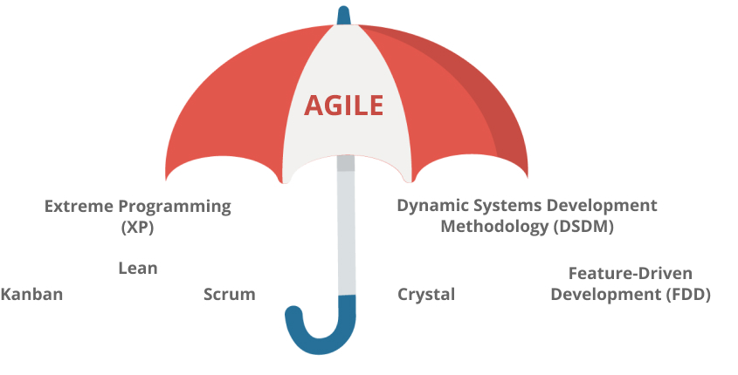
Agile Frameworks

Slide 8
Scrum
Scrum is by far the most popular of all available frameworks.
It's about 70% of the Agile teams use either Scrum or one of these variants.
Sometimes people equate Agile to Scrum which you, of course, you can see that it's not true. There are so many frameworks out there that you can use for your Agile implementation.

